Slide 1


Impact of Social Sciences, Humanities and Arts Conference
Opening Session on:
Transforming Policies and Strategies to Support Societal Impact
14 October, 2021

Slide 2


Impact of Social Sciences, Humanities and Arts
13-15 October, 2021
Michael Gastrow: Acting Director- Science in Society at the HSRC, South Africa
Beverley Damonse: Executive of Science Engagement and Corporate Relations, National Research Foundation (NRF), South Africa
Otto Bruun: Chair of UAS4EUROPE Management Committee and Senior Innovation Advisor at SwissCore
Overview of the Keynote Speakers
#SSHA21

Slide 3
Impact of Social Sciences, Humanities and Arts
13-15 October, 2021
Beverley Damonse
Executive of Science Engagement and Corporate Relations, National Research Foundation (NRF), South Africa
#SSHA21

Slide 4

Transitions Towards Enhanced Impact
Beverley Damonse (PhD)
National Research Foundation of South Africa (NRF)
Impact of Social Sciences, Humanities and Arts AESIS Conference
14th October 2020

Slide 5
(SSHA)impact on society in need of improved:
Supporting structures, policies and strategies
Strong impact frameworks for assessing and stimulating impact
Collaborations with partners from business, Government and not-for-profit sectors
Engaging with the broader public
(Conference Programme –SSHA Conference 2021)

Slide 6
National Structural Changes (?)
The HESTIIL REVIEW (2020)
A review of South Africa’s Higher Education, Science, Technology and Innovation Institutional Landscape
A new pathway 2030: catalysing South Africa’s NSI for urgent scaled social and economic impact
Largest social challenges remain poverty, unemployment and inequality
Inclusivity, sustainability and transformation are key desired outcomes
Notes:
. he report provides a comprehensive and insightful review of the sector. It includes a situational and capacity analysis as well as an institutional landscape mapping. The analysis accurately identifies many of the concerns facing the NSI, with a focus on coherence and cooperation and the need to pursue the societal benefit which the sector can and should yield.

Slide 7

National Level
WHITE PAPER on STI (2019)
Focus on using STI to accelerate inclusive economic growth.
Innovation for inclusive development
Develop local innovation eco -systems
Grassroots innovation for inclusive development
Creating an innovation culture in partnership with civil society
Building a science literate and science aware citizenry
Principles of Responsible Research and Innovation (ethics/ sustainability/societal benefit/
Trans disciplinarity
Notes:
Develop local innovation ecosystems - To bolster innovation for inclusive development, the White Paper introduces a significant policy shift in including civil society in STI planning at all levels, and devoting resources to supporting grassroots and other neglected innovators. The realisation of the ambitions of this White Paper will in part depend on building an innovation culture in society and developing a science-literate and aware citizenry.

Slide 8

Implementation of the NRF’s Framework to Advance the Societal & Knowledge
Impact of Research
(2021)
Notes:
The NRF’s Vision 2030 positions the organisation to enable, facilitate and perform excellent research which seeks to extend knowledge frontiers and address national challenges. To achieve this ambition, the NRF is advancing a research impact agenda.

Slide 9
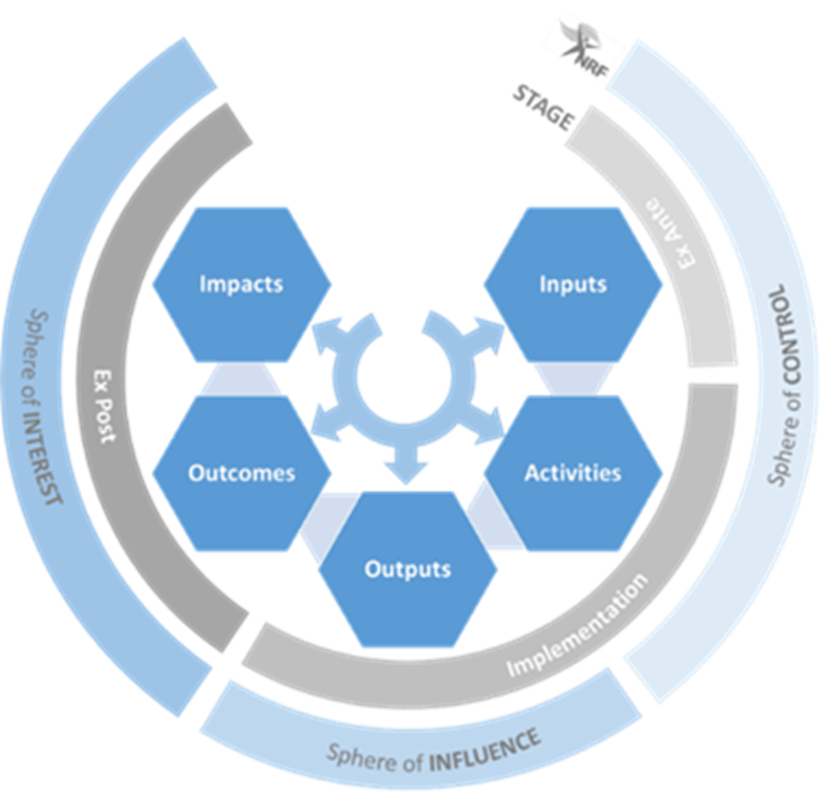
Notes:
A beneficial change in society or knowledge advancement brought about as the direct or indirect result of the NRF’s research support interventions, whether planned or unintended; immediate or long-term.

Slide 10
High-level implications for the NRF
Policy coherence: policies and strategies to consider impact, potential impact, advancing impact.
Rewards and incentives: recognition of impact/ impact pathways.
Assessment Practices: along all stages
Improved impact literacy: In NRF, researchers, NSI, and more.
Partnerships and agreements: To reflect our focus on impact, to be assessed based on potential impact, and to be established with end-users and stakeholders (assessment & reporting, outcome working groups - government/ business).
Enablers: mission-oriented, inter-disciplinary, and engaged research throughout all parts of the NRF.

Slide 11
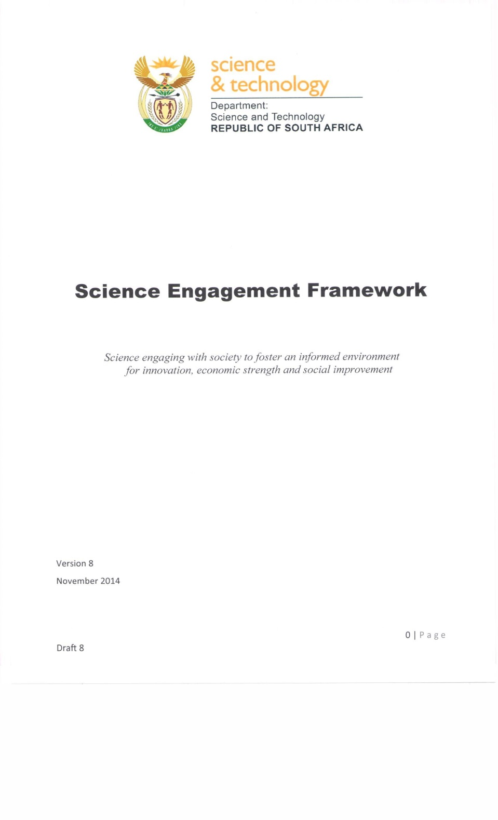
Engagement with broader public(s)
….informed by the values of contemporary, post-apartheid South Africa;
….imperative of empowering its citizens to engage processes and issues that impact on their lives; and
…systematise , coordinate, professionalise, ...raise profile of science communication.
Notes:
DST Science Engagement Strategy, Jan 2015 .First of its kind for the DST and its entities.
Attempts to
Systematise through increased coordination (beyond NRF)
Professionalise science communications
Raise status of S&T in public and political perception
Transcend deficit model philosophy

Slide 12
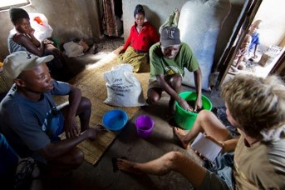

NRF Statement on Engaged Research
Engaged Research as research that:
integrates considered approaches to engaging communities and society in, and with, the research across its full cycle, ensuring communities are primary stakeholders, active contributors as well as beneficiaries of research;
encompasses the multitude of ways researchers interact with stakeholders and communities over the various phases of research processes
aims to improve public trust in science and enhance the democratisation of science; and
improves the relationship between science and society.
Principles of:
Active citizenship
Reciprocity
Trans-and Interdisciplinary knowledge production
Ethics and sustainability
Relationship Building

Slide 13
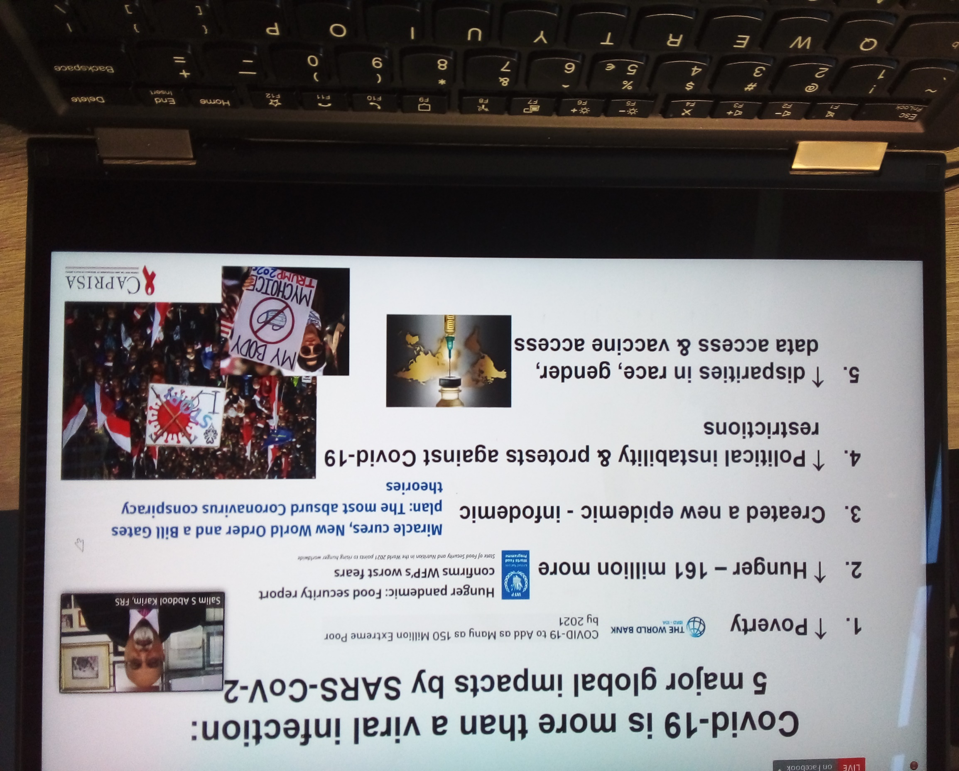
Transitioning cautions….
‘Perils of Impact (
Notes:
Unique social, cultural, economic, and political complexes shape contexts and hence the intended and unintended impacts.
Engagement value high when science is controversial or when human contexts are most complex and/or /contentious.
‘Perils of Impact’– linearity/ unpredictability/measurement /instrumentalization/

Slide 14
Impact of Social Sciences, Humanities and Arts
13-15 October, 2021
Otto Bruun
Chair of UAS4EUROPE Management Committee and Senior Innovation Advisor at SwissCore
#SSHA21

Slide 15
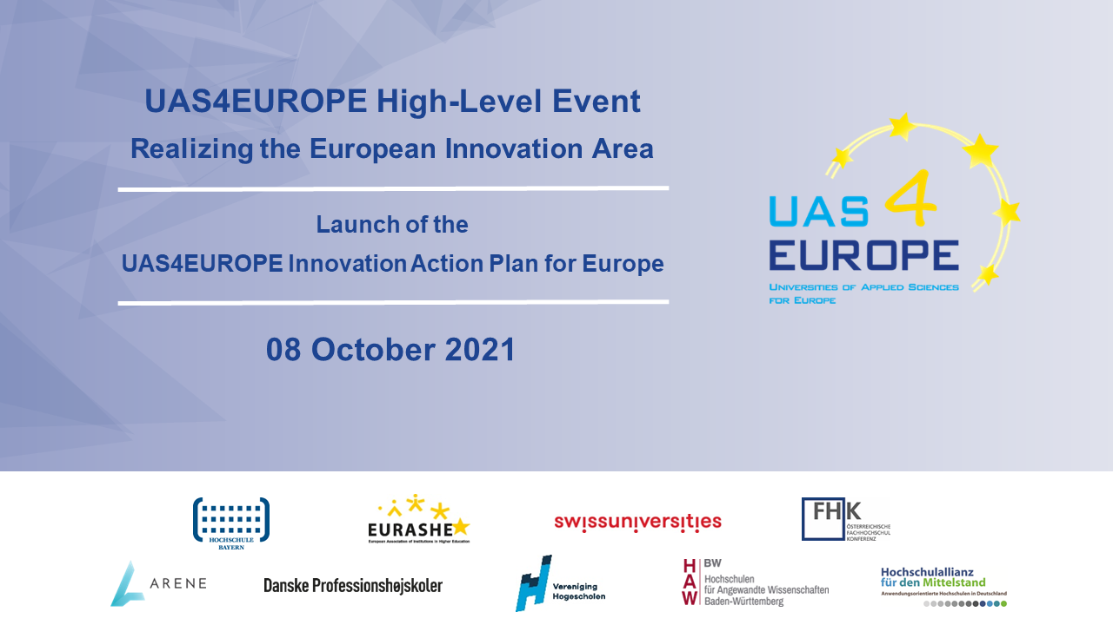

Slide 16

Presentation of the Innovation Action Plan
By Prof. Marjolijn Brussaard,
Co-Chairwoman of UAS4EUROPE
info@uas4europe.eu
www.uas4europe.eu

Slide 17






Our current members
02
Chairwomanship
June 2021 – May 2022
Co-Chair
swissuniversities
Representing all Swiss institutions of higher education, including 7 UAS
Vereniging Hogescholen
Representing all 36 public - funded UAS of the Netherlands
EURASHE
Representing over 600 institutions in European Higher Education Area
Hochschule Bayern e.V.
Representing
20 Bavarian UAS
Fachhochschul-konferenz
Representing all 21 Austrian UAS
Danske Professionshøjskoler
Representing all 8 UAS of Denmark
ARENE
Representing
24 Finnish UAS
Hochschulallianz für den Mittelstand
Representing
12 German UAS
HAW BW
Representing
24 UAS in the region of Baden-Württemberg

Slide 18



Our Mission – Promoting the UAS model
03
Strengthening the voice of UAS in Europe
Networking platform & knowledge exchange
Reaching out to European institutions and stakeholders

Slide 19
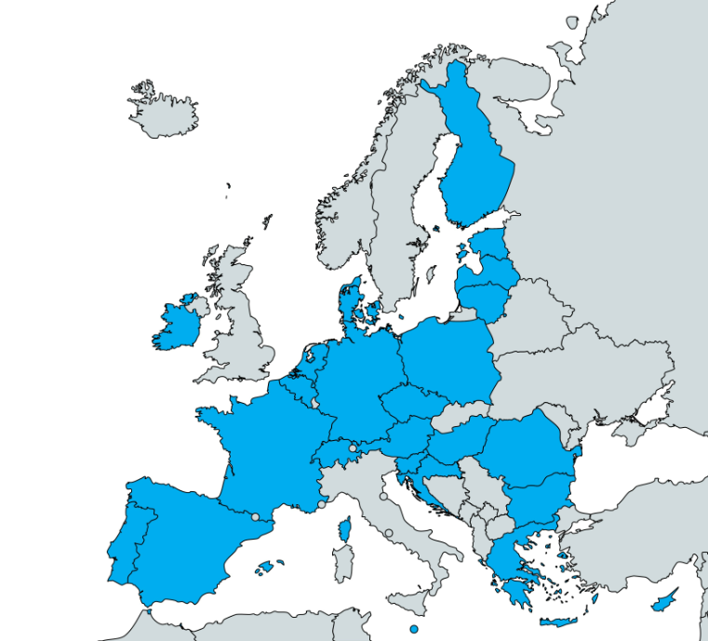
Facts & Figures
04
Over 2.000.000 students
60.000+ research staff
More than 450 UAS
9 member associations
Notes:
Representing UAS in more than 20 European countries (precisely: 24)

Slide 20
The Innovation Action Plan for Europe
Structure
05
Strengths of UAS
Practice-based
Transdisciplinary
Link between basic research & market application
Regionally embedded
Notes:
Practice-based approach promoting an entrepreneurial mind-set of students
Responding to transdisciplinary challenges, creating regional impact
Missing link between basic research and market application
Regional embeddedness, drivers of innovation ecosystems

Slide 21
The Innovation Action Plan for Europe
Structure
06
Challenges & Opportunities
European scale
Regional scale
Notes:
European challenges
competing in next technology wave,
connecting innovation to welfare,
creating future dynamic economies,
fostering diversity and inclusivity,
skills gap
Regional challenges
Mitigating tech transfer weaknesses,
linking fragemented innovation ecosystems/promoting innovation cohesion,
promoting open science and open innovation policies,
broadening participation in European programmes

Slide 22
The Innovation Action Plan for Europe
Structure
07
What can you do for UAS?
Recommendations
Shorter time-frame support instruments
Deeper links between ERASMUS+, COSME & EIT
EIT KICs & European Universities Initiative
European Innovation Ecosystems
Notes:
Shorter time-frame support instruments, more adapted to the duration of applied research projects would help increase the contribution of applied research institutions
To nurture the innovative entrepreneurs of tomorrow, we should develop strong synergies between EU programmes addressing entrepreneurship in all its facets, including collaborative, applied research activities in curricula. This could take the form of deeper links between ERASMUS+, COSME’s successor programmes for entrepreneurs and the EIT.
To connect the complementary strengths of UAS and traditional research intensive universities, the integration of UAS in the instruments of EIT KICs and the European Universities Initiative should be reinforced. Addressing the skills gap requires the contribution of all types of higher education institutions.
Develop support within the European Innovation Ecosystems (EIE) instrument to better connect actors within applied research across Europe to seek synergies across national and regional innovation strategies, including benchmarking activities and scaling UAS-led projects from regional to European levels,

Slide 23


Thank you for your attention!
Contact:
www.uas4europe.eu
info@uas4europe.eu
Follow us on:

Slide 25
Impact of Social Sciences, Humanities and Arts
13-15 October, 2021
Thank you!
#SSHA21

